Slide 1

AI App/ Project Name
User Manual
Author: Ikhlaas Moin
Notes:
Preworks course home assignments

Slide 2
Table of Contents
Acknowledgements
About Me..
About My Internship Journey with Clevered..
About App..
Guide on how to use app
Personal Contacts

Slide 3
Acknowledgements
I would like to credit all the members who helped me at Clevered such as Mr. Avishek and I would like to appreciate Mr. Ken to attend my presentation.

Slide 4
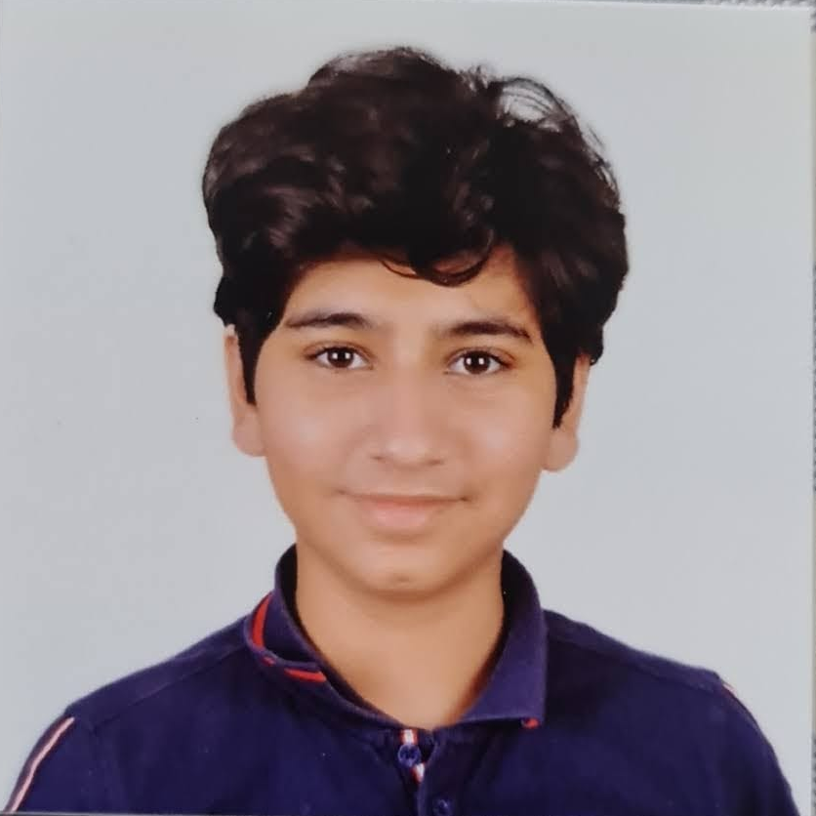
About Me..
Picture of me
Ikhlaas Moin, 15, 10th Grade, Student
My Interest in AI comes from my love of creating and AI is a
tool that lets me make things that go even past my own
knowledge
AI spans much more than a job as an AI engineer, AI can be
used if I want to be an engineer anywhere, and statistics and AI
are very helpful tools when starting and growing a business
My goal is to develop a sense of critical thinking of AI and
where all it can be used.

Slide 5
About My Internship Journey with Clevered..
I have enjoyed the internship journey, and it has helped me make lots of new things
It has been and honor to intern to an expert in the industry (Dr. Ken)
I have gotten Rockstar badges for all the attendance and homework
I have learned a lot while working on this project.

Slide 6
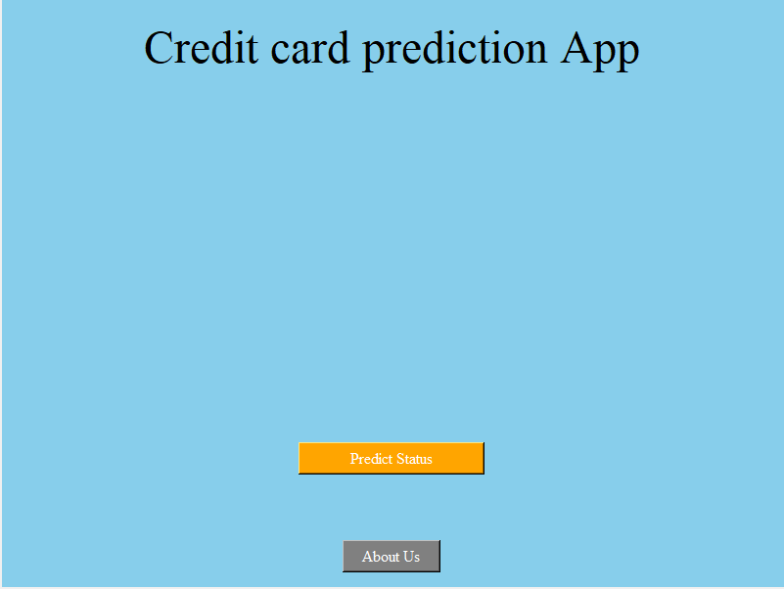
About App..
App’s Main Menu
App’s Introduction
Predict Status: Sends you to the entry form
About Us: Plays an audio providing more information about the project

Slide 7
How do I use the App?

Slide 8
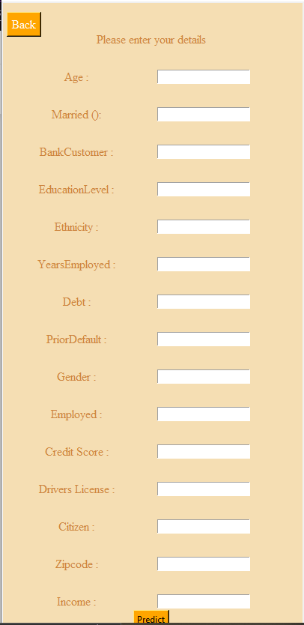
Entry Form
Fill in the necessary data In the Form
Clicking the “Back” Button sends you back to the main menu.
Once all the data is filled, press “Predict” to receive results

Slide 9
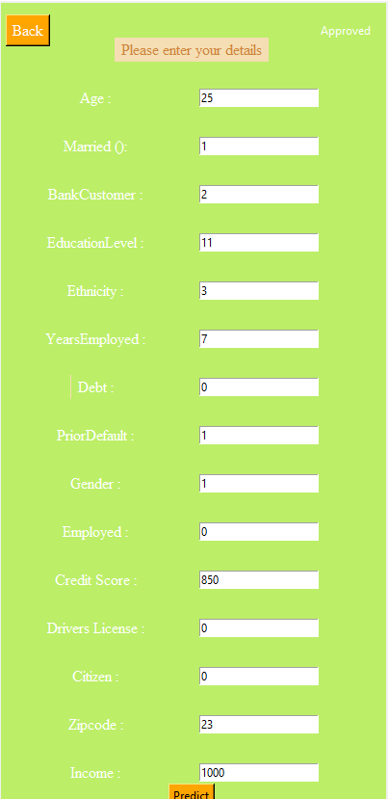
Option Name(This will be repeated for each option of the App)
This is How the Entry Form appears if you are approved

Slide 10
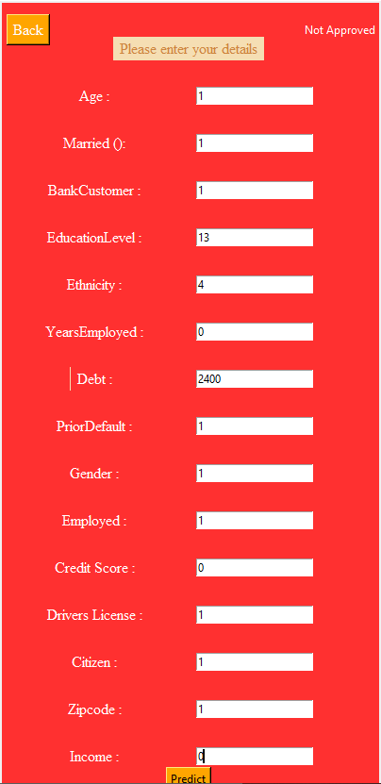
Option Name(This will be repeated for each option of the App)
This is how the entry forms looks when you have been denied.

Slide 11
Contact Person
Please reach out to me at Ikhlaas.iksi1234@gmail.com for any questions/ concerns/ suggestions on the App.

Slide 12
Thank you!

